Slide 1
Comparison between application VMs
Group 3

Slide 2
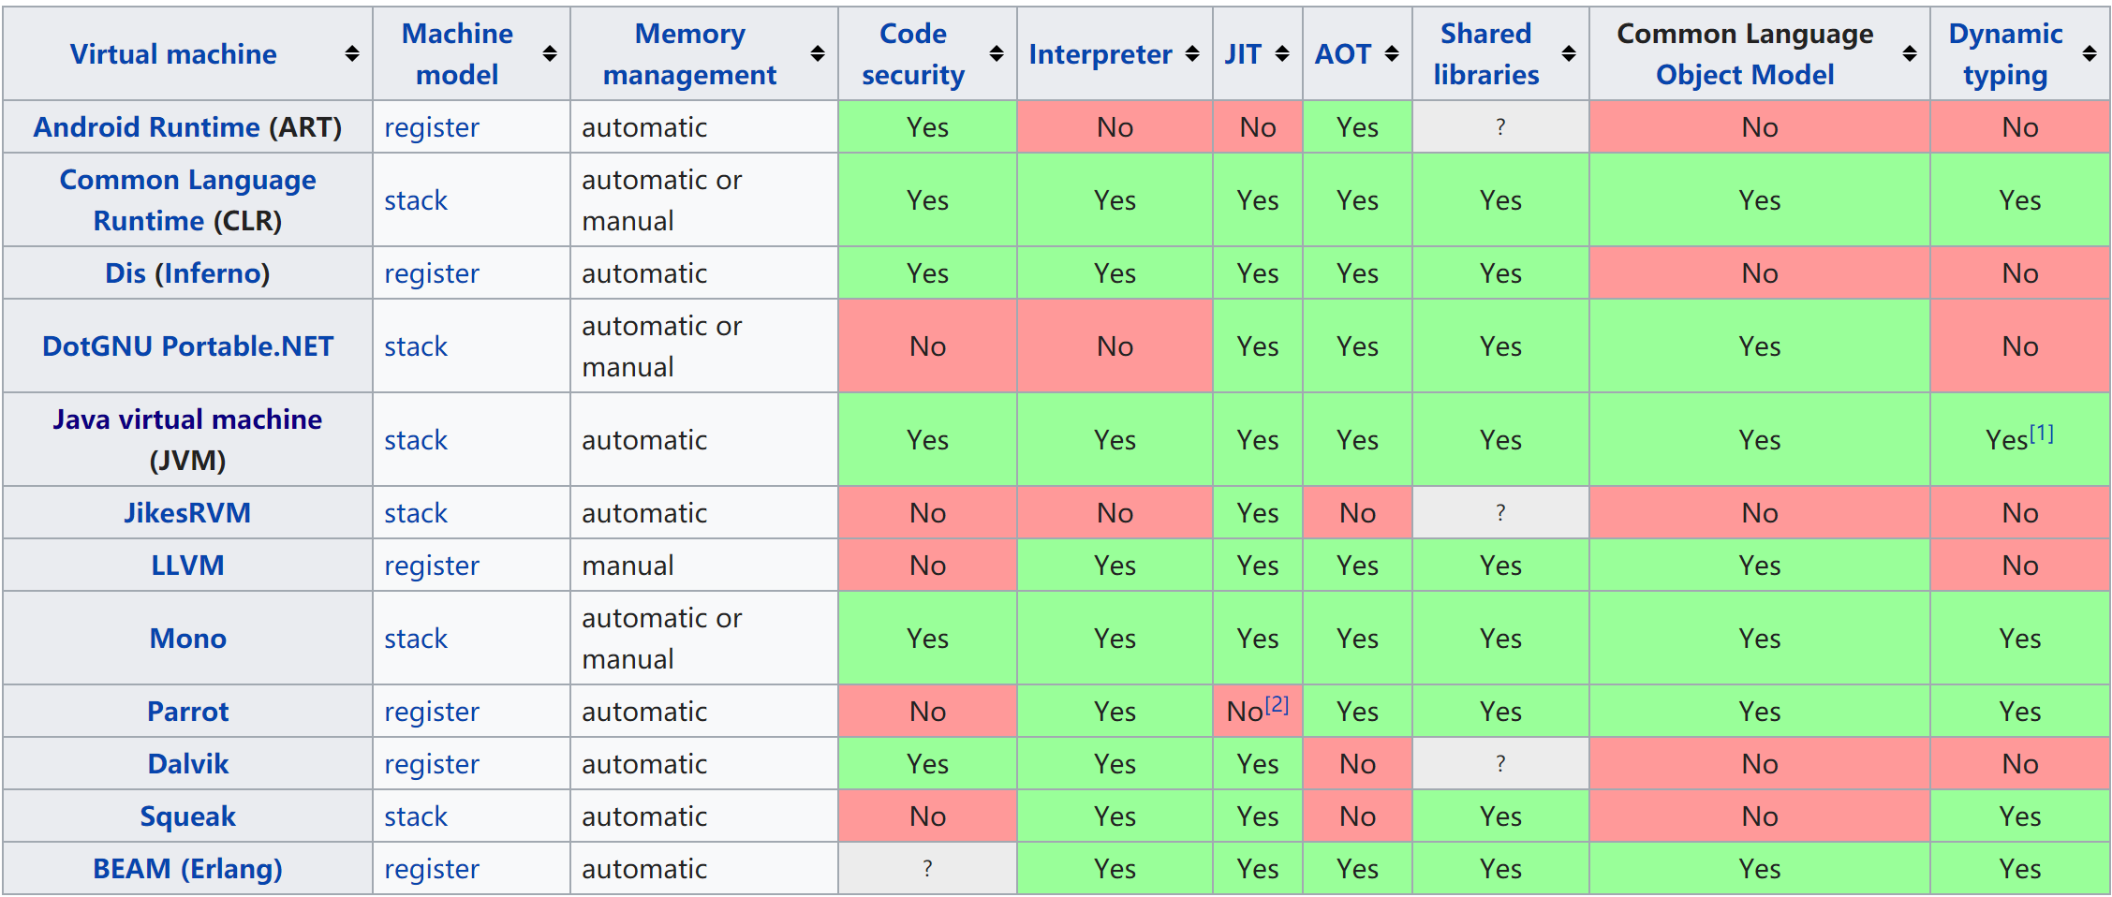
Source: https://en.wikipedia.org/wiki/Comparison_of_application_virtualization_software

Slide 3
Computation models
Stack machine
Register machine
Last in, first out (LIFO)
Addressing (direct, indirect)

Slide 4
Advantages
Stack machine
Register machine
VERY compact object code
Simple compilers & interpreters
Quick access
Fetches instruction and operand at the same time
Avoid passing through memory
Faster interpreters*
Minimal hardware

Slide 5
Disadvantages
Stack machine
Register machine
More memory references
Common subexpressions expensive
Rigid code order
Slower interpreters*

Slide 6
Faster or slower interpretation??

